Slide 2
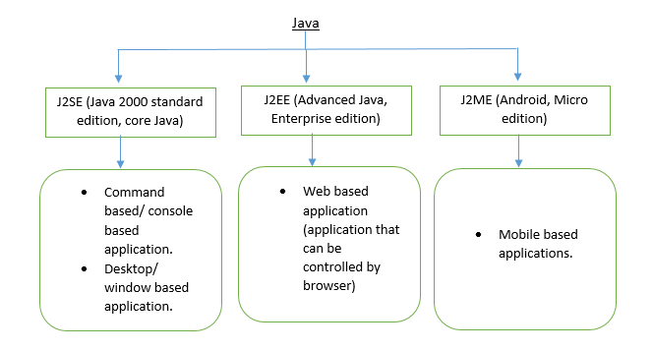
Java Editions

Slide 3
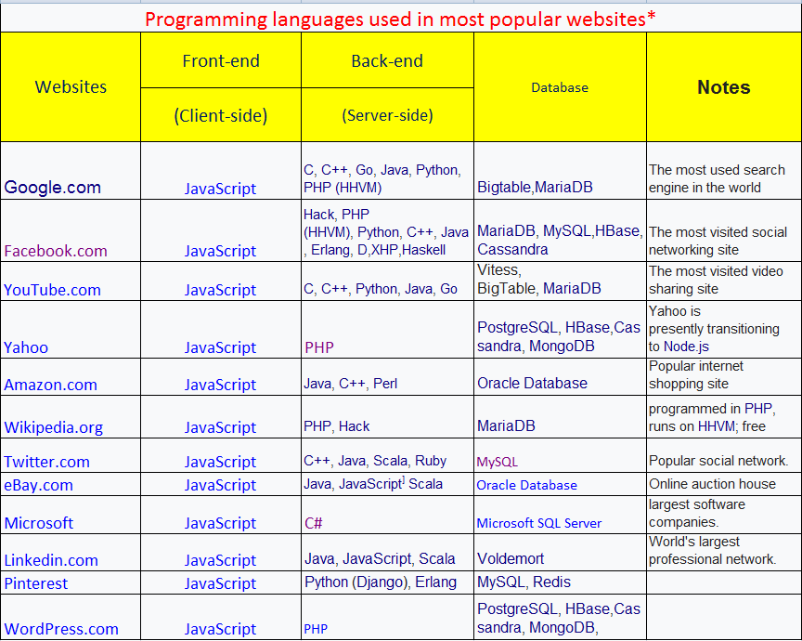

Slide 4
Data and Information

Slide 5
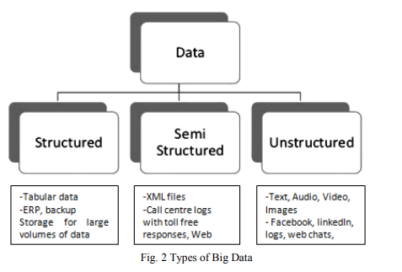
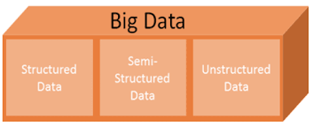
DATA AND INFORMATION
Data and information in an organization are used for the analysis of relatively structured and unstructured data and semi structure.
Unstructured data is raw and unformatted, the kind of data that you find in a simple text document, where names, dates and other pieces of information are scattered throughout random paragraphs.
Semi-structured data is information that doesn’t consist of Structured data (relational database) but still has some structure to it.

Slide 6
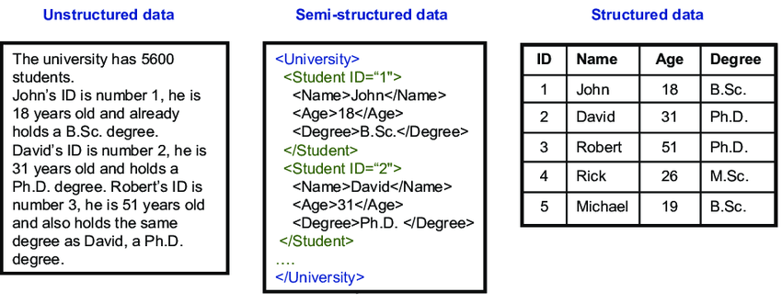
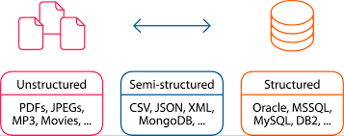

Slide 7
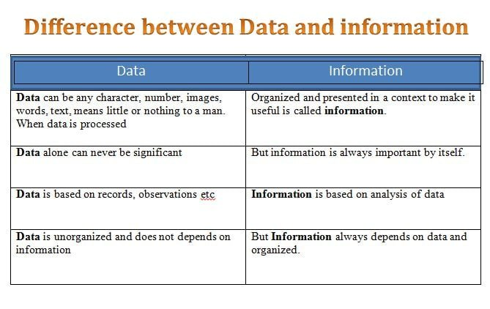
Examples of Information: “John lives at house No. 558 in New York.” “He can run 10 Kilometers a
day.” “United States is a powerful country.”
Examples of Data: John, 558, New York, United States, 10, Kilometers

Slide 8
Data Base Management System (DBMS)

Slide 9
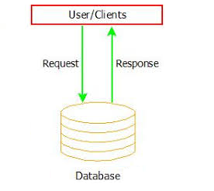
What is Database
A database is an organized collection of data, so that it can be easily accessed and managed.
It is also used to organize the data in the form of data into tables, rows, columns, and index it to make it easier to find relevant information.
The main purpose of the database is to operate a large amount of information by storing, retrieving, and managing data
Eg: College or University Database organizes the data
Admin
Staff
Student
Faculty
Data is related to any object like
st_Id,st_name, st_age,image,file etc…

Slide 10
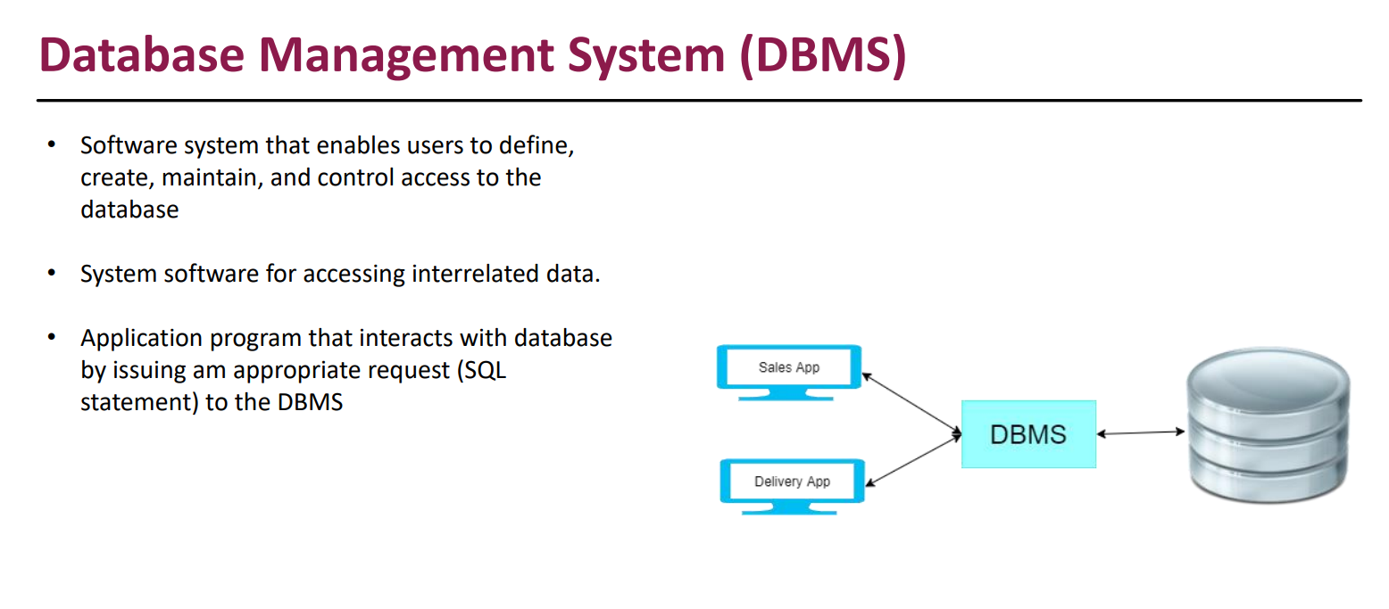

Slide 11
What is RDBMS
RDBMS stands for Relational Database Management Systems.
All modern database management systems like SQL, MS SQL Server, IBM DB2, ORACLE, My-SQL and Microsoft Access are based on RDBMS. because it is based on relational model introduced by E.F. Codd.
How it works:
Data is represented in terms of in RDBMS.
It contains number of tables and each tuples (rows) able has its own primary key.
Due to a collection of organized set of tables, data can be accessed easily in RDBMS

Slide 12
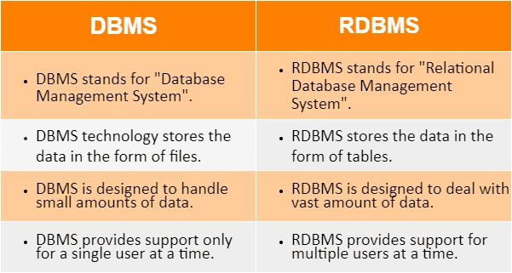
DBMS VS RDBMS

Slide 13
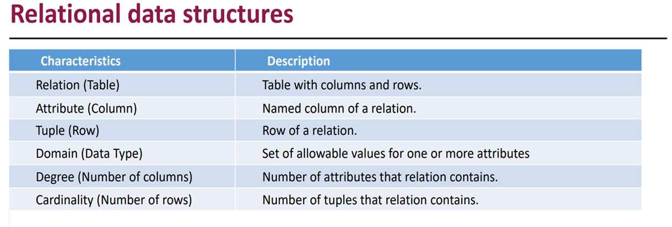

Slide 14
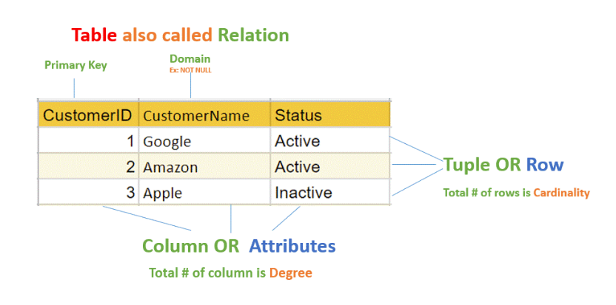
Relation Data Structure

Slide 15
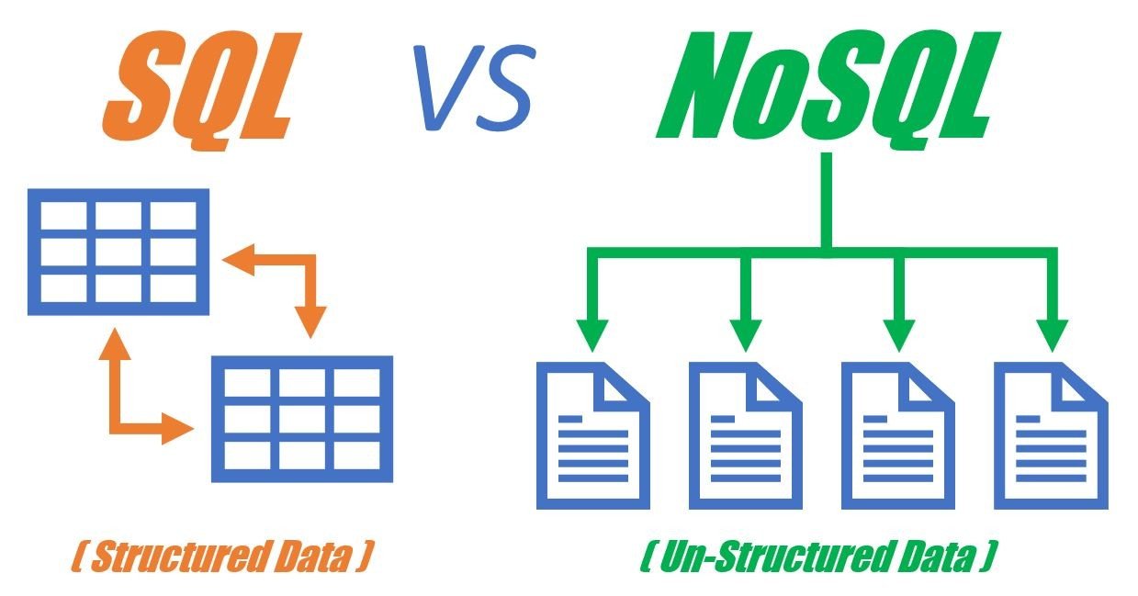

Slide 16
What is SQL?
SQL stands for Structured Query Language.
It's used in Relational Databases (like MySQL, Oracle).
Data is stored in tables (like Excel sheets).
Tables have rows and columns.
You need to define the structure (schema) before adding data.
Imagine a school student list:
Roll No | Name | Age
101 | Ravi | 16
102 | Priya | 15

Slide 17
What is NoSQL?
NoSQL means Not Only SQL.
It's used in Non-Relational Databases (like MongoDB).
Data is stored in documents (like Word or JSON files).
Data is unstructured or semi-structured (like JSON, key-value pairs)
Stores large, changing, or real-time data quickly
Example:
Imagine a WhatsApp chat / Instagram / Facebook Posts
{
"name": "Ravi",
"message": "Hi",
"time": "10:01 AM"
}
This is NoSQL – flexible like a conversation log.

Slide 18
SQL = Like Excel Sheets (organized, rows and columns)
Information can be extracted using SQL queries:
SELECT Name, Class FROM Students WHERE Age > 14;
Output: Ravi | 10
Suitable for:
Attendance system ,Fee management,Exam results
NoSQL = Like WhatsApp Messages (flexible, fast, different every time)
Information is read from this document directly, no joins needed.
Suitable for:
Chat applications
Social media feeds
Product reviews

Slide 19
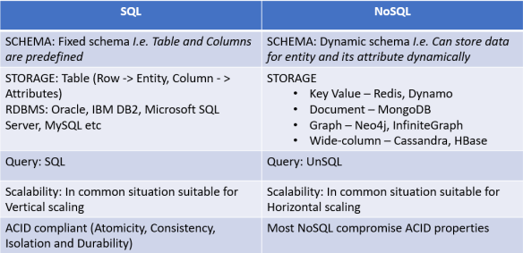

Slide 20
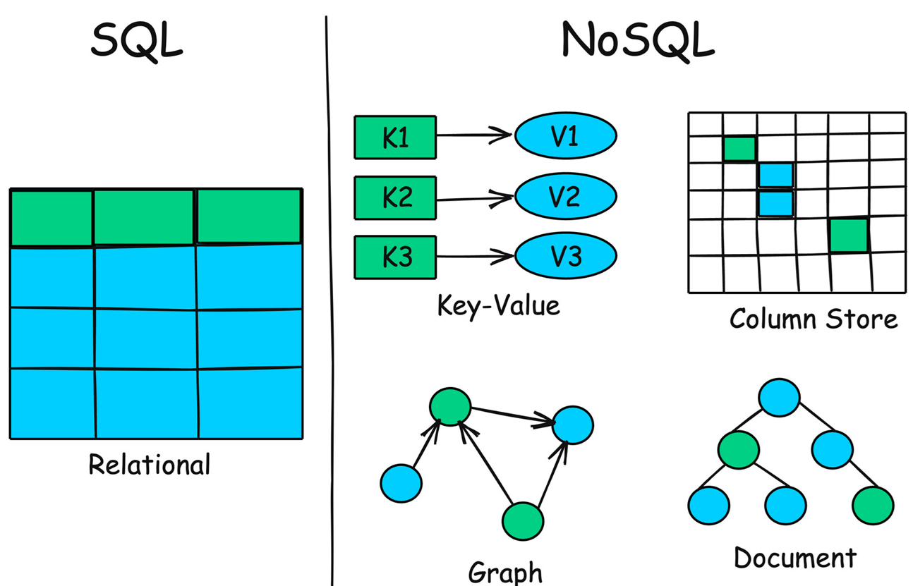
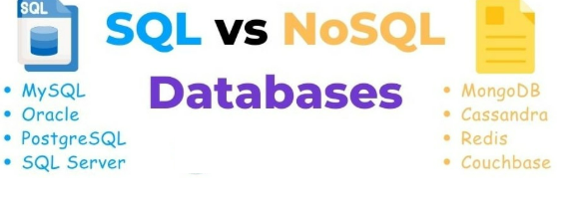

Slide 21
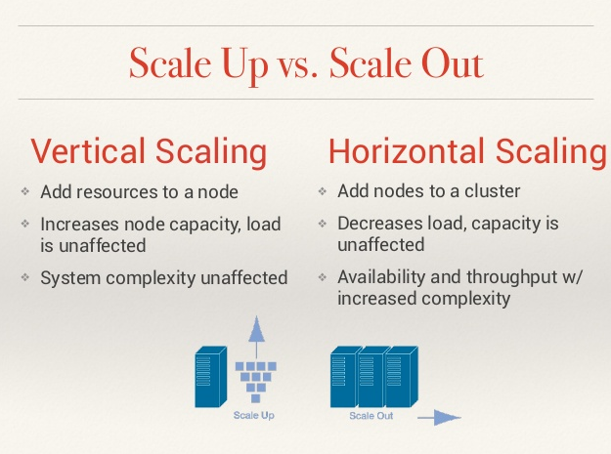
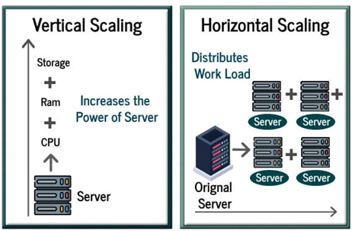

Slide 22
SQL Databases in Real-Time Industry Applications
Industry | Company / Application | Database Used | Real-Time Usage
Social Media | Instagram | PostgreSQL | Real-time feed generation, stories
E-commerce | Shopify | MySQL | Real-time order processing, inventory
Streaming | Netflix | MySQL (via Vitess) | Video metadata, payments
Travel / Booking | Booking.com | PostgreSQL | Real-time availability and pricing
Finance / Banking | Goldman Sachs | Microsoft SQL Server | Real-time transaction records
Enterprise | Stack Overflow | SQL Server | Real-time Q&A search and updates
Industry | Company / Application | Database Used | Real-Time Usage
Social Media | Instagram | PostgreSQL | Real-time feed generation, stories
E-commerce | Shopify | MySQL | Real-time order processing, inventory
Streaming | Netflix | MySQL (via Vitess) | Video metadata, payments
Travel / Booking | Booking.com | PostgreSQL | Real-time availability and pricing
Finance / Banking | Goldman Sachs | Microsoft SQL Server | Real-time transaction records
Enterprise | Stack Overflow | SQL Server | Real-time Q&A search and updates

Slide 23
NoSQL Databases in Real-Time Industry Applications
Industry | Company / Application | Database Used | Real-Time Usage
Ride-Sharing | Uber | MongoDB + Cassandra | Real-time trip tracking, pricing
Social Media | Snapchat | Cassandra | Real-time messaging & media
Search / Analytics | GitHub | Elasticsearch | Real-time code search
Online Ads | Meta (Facebook Ads) | RocksDB, Cassandra | Real-time ad bidding and targeting
Gaming | Discord | Redis + Cassandra | Real-time chat & presence tracking
News / Media | The New York Times | Firebase Realtime DB | Real-time updates to readers
E-commerce | Amazon | DynamoDB | Real-time shopping cart, inventory
Monitoring / DevOps | Netflix (monitoring stack) | Elasticsearch | Real-time log analysis (via ELK)

Slide 24
Both SQL vs NoSQL
Use Case | Best Real-Time DBs Used in Industry
Real-time messaging | Cassandra, Redis (Snapchat, Discord)
Real-time search | Elasticsearch (GitHub, Wikipedia)
Real-time analytics/dashboard | PostgreSQL, Elasticsearch, MongoDB (Uber, Netflix)
Real-time transactions | MySQL, SQL Server, DynamoDB (Shopify, Amazon)
Real-time location tracking | Cassandra, MongoDB (Uber)
Real-time sync (mobile/web) | Firebase (NYT, Trivago)

Slide 25
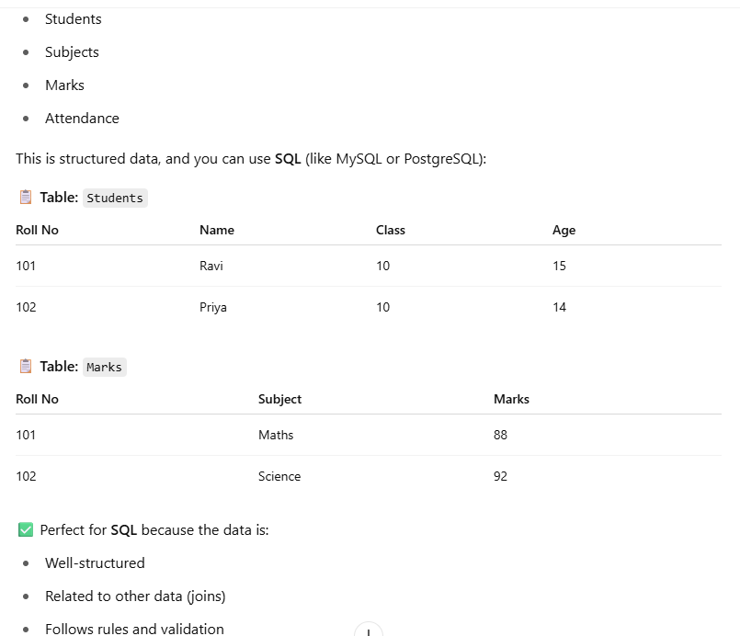
Scenario 1: School Management System (SQL)

Slide 26
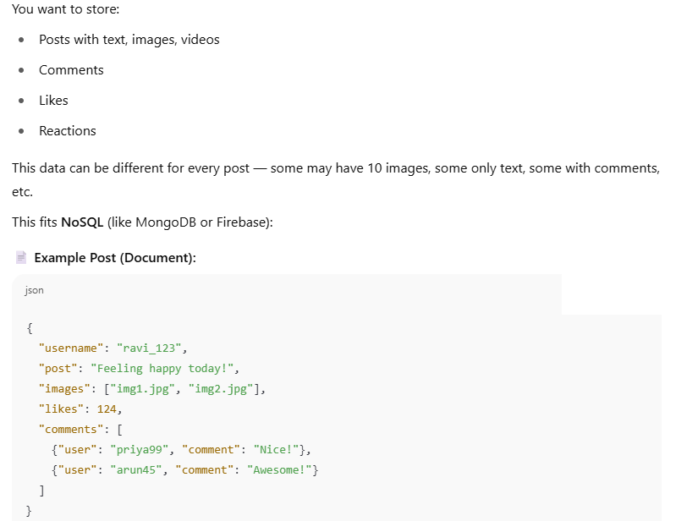
Scenario 2: Instagram / Facebook Posts (NoSQL)

Slide 27
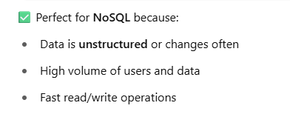
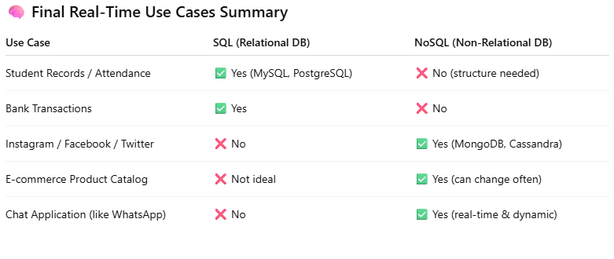
Scenario 2: Instagram / Facebook Posts (NoSQL)

Slide 28
Configuration and Install of MYSQL

Slide 29
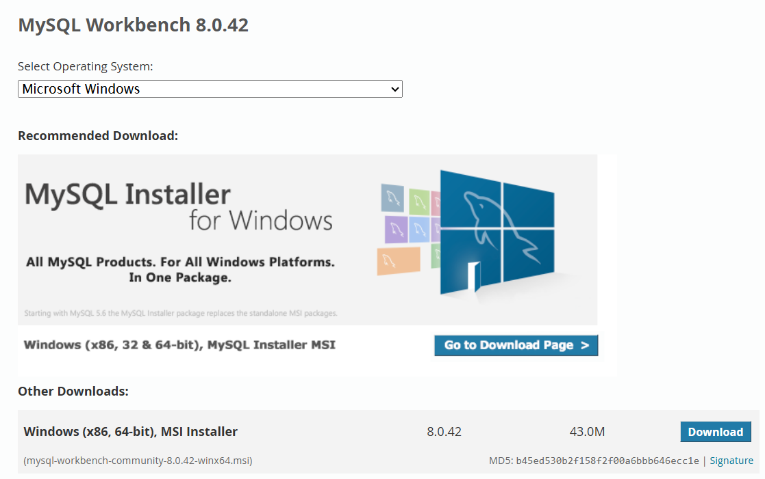
https://dev.mysql.com/downloads/workbench/
https://dev.mysql.com/downloads/workbench/

Slide 30
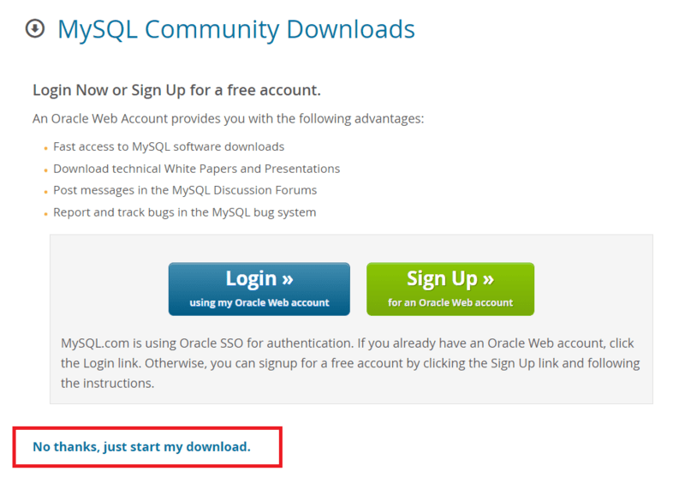
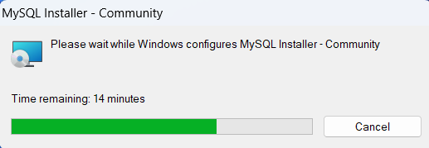
Step 2: Go to the Downloads Section

Slide 31
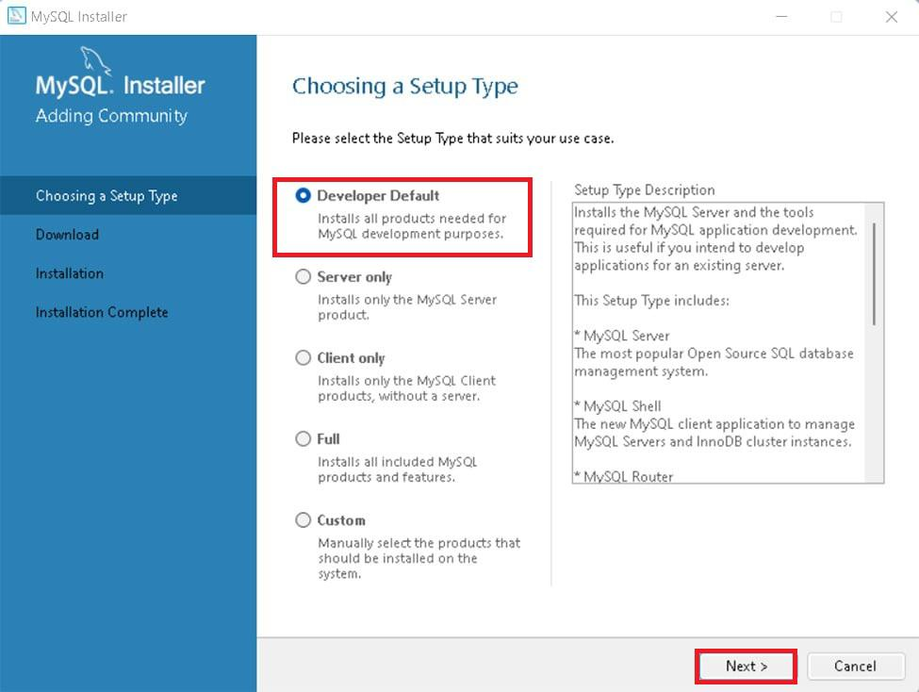
Step 4: Choose Setup Type

Slide 32
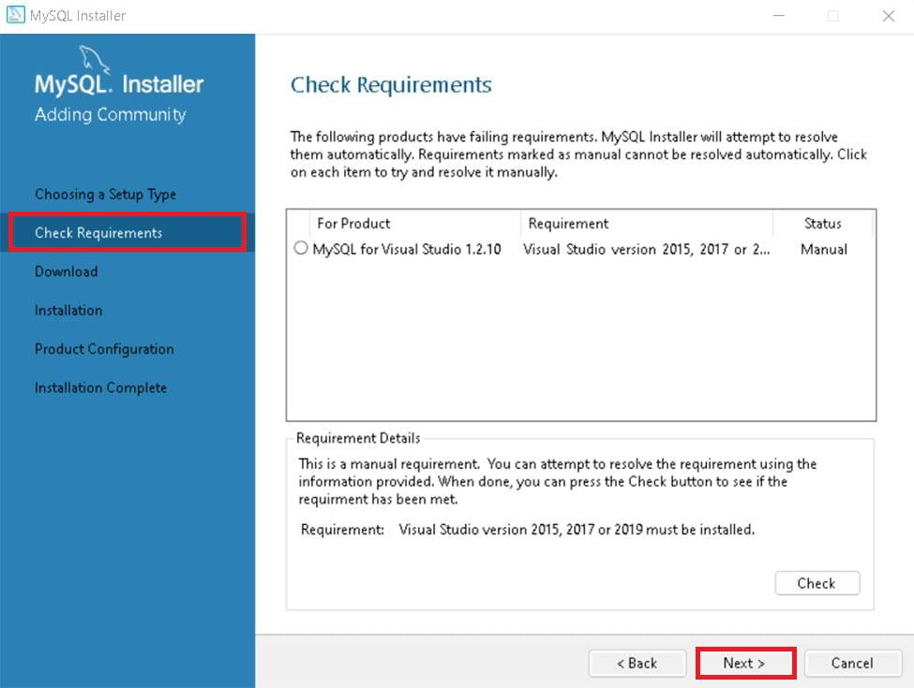
Step 5: Check Requirements

Slide 33
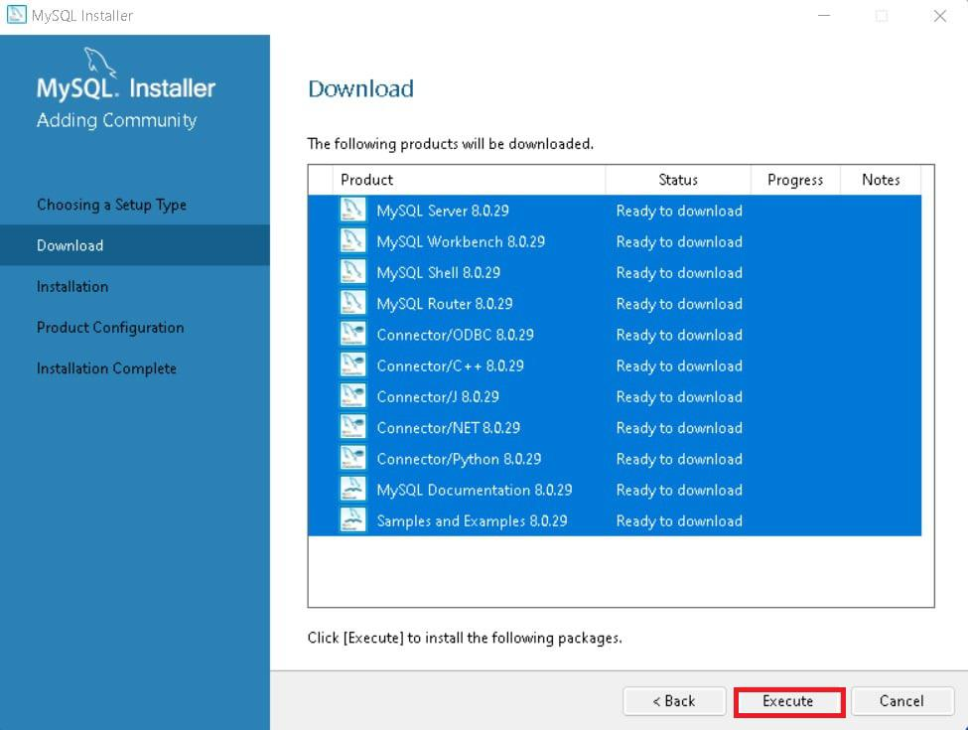
Step 6: MySQL Downloading

Slide 34
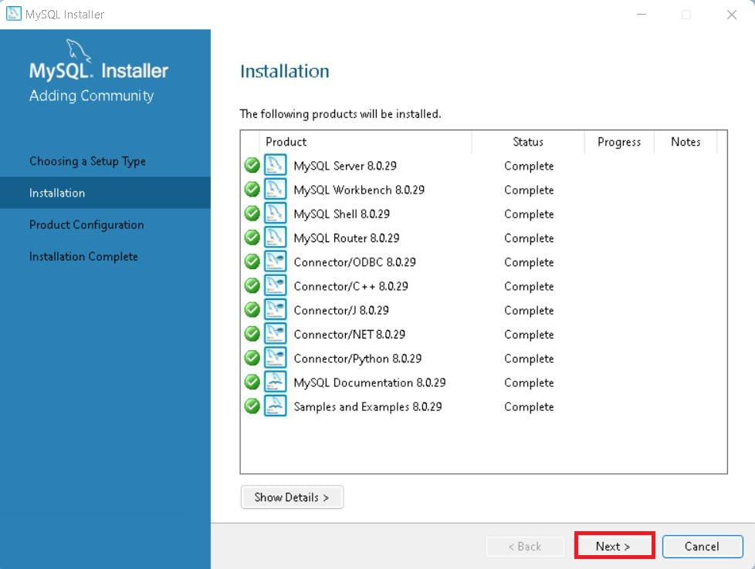
Step 7: MySqL Installation

Slide 35
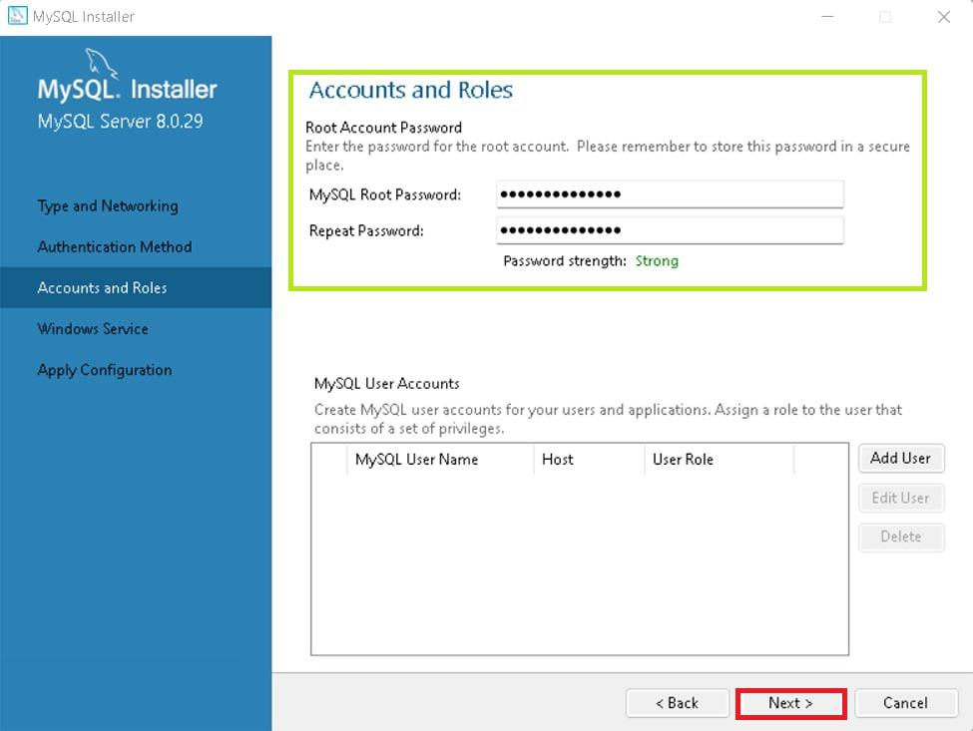
Step 9: Create MySQL Accounts

Slide 36
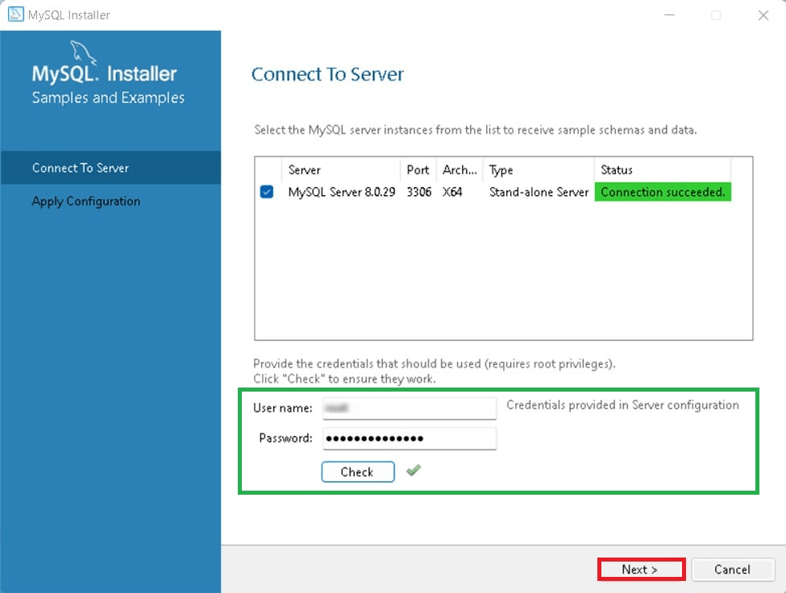
Step 10: Connect To Server

Slide 37
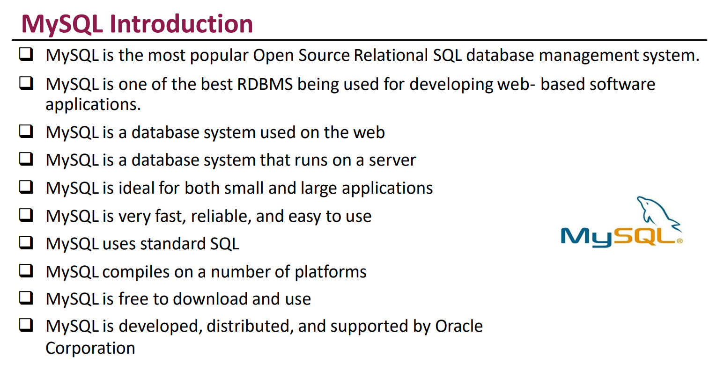

Slide 38

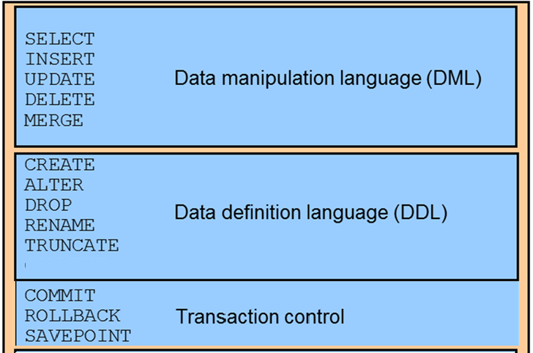

Slide 39
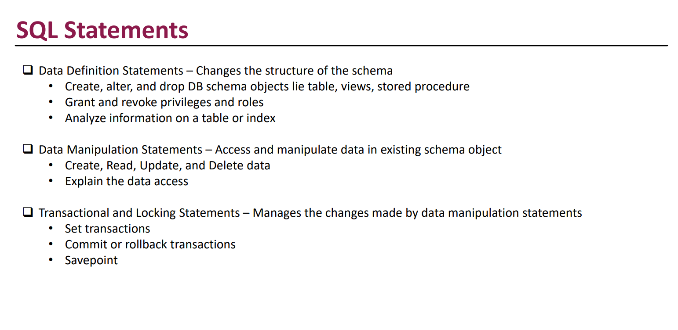

Slide 40
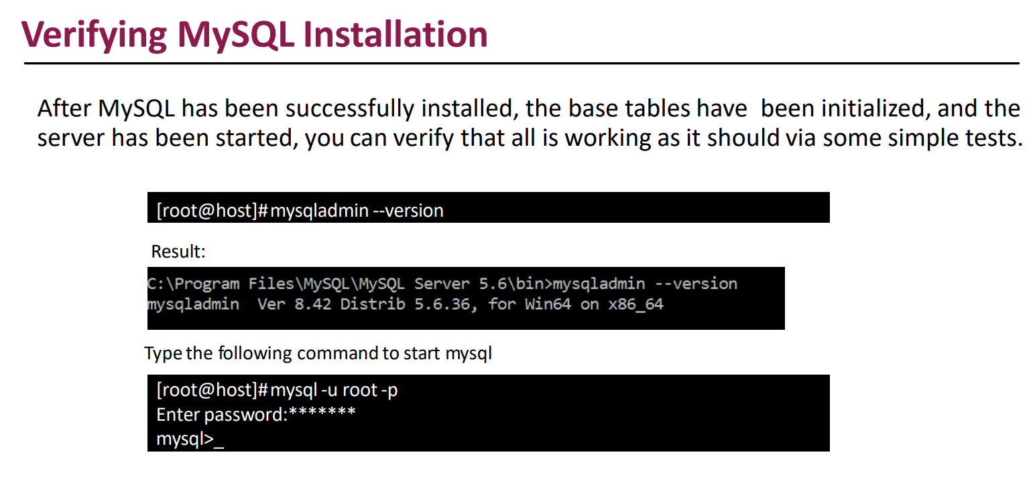

Slide 41
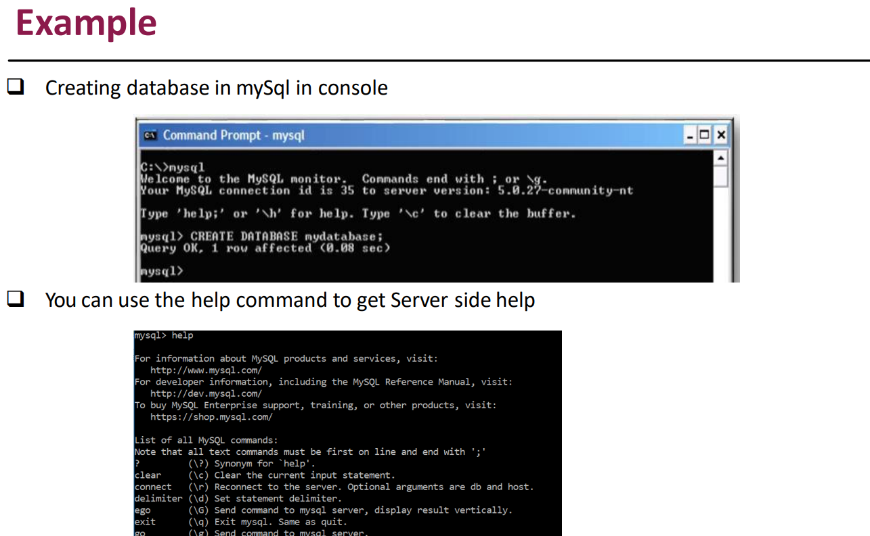

Slide 42
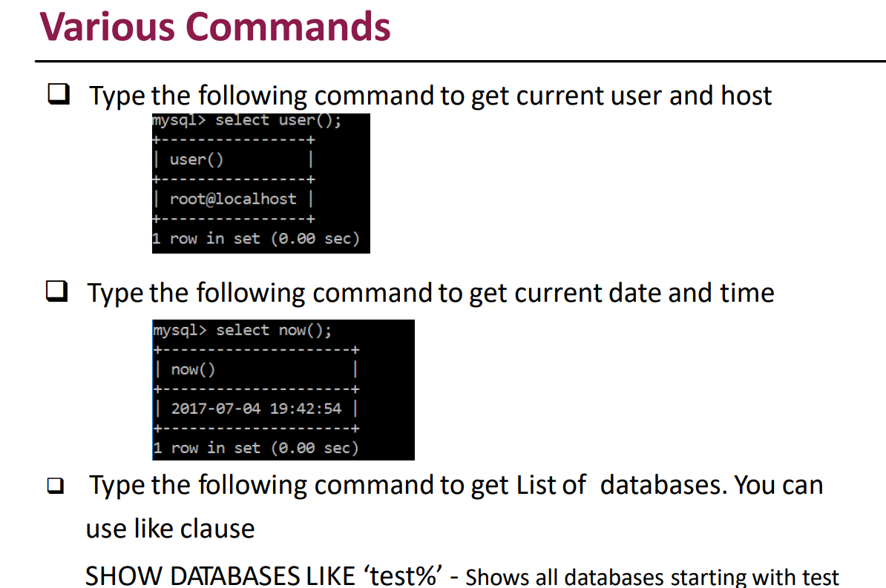
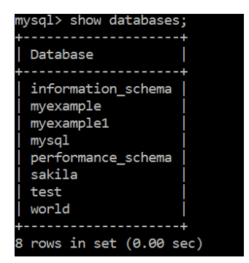

Slide 43

